Slide 1

Task Management System Java Programming CSCI – 2210 – 01 TEAM WORA
Spring 2021
Notes:
Anta

Slide 2
Team Members & Roles
Team Name
WORA
Team Members
Ahmed Muntasir Hossain ahoss1@unh.newhaven.edu (Team Head)
Emily R. Carlow ecarl3@unh.newhaven.edu (Team Member)
Jake E. Sullivan jsull10@unh.newhaven.edu (Team Member)
Anta R. Fall afall2@unh.newhaven.edu (Team Member)
Nathan A. Platt nplat2@unh.newhaven.edu (Team Member)
Roles of Team Members
Each team member contributed equally towards the following roles: Programmer, Researcher, UX/UI Designer, Report Writer, Create Task Page, Search for Tasks Page, and Calendar Page Specific Contributions to the Application
Ahmed Muntasir Hossain: Database Administrator, User Menu, Tasks for this Week, New User List
Emily R. Carlow: User Sign Up and Log in, Create New Admin Account, Approved User List
Anta R. Fall: Admin Sign Up and Log in
Jake E. Sullivan: Database Administrator, Exit
Nathan A. Platt: Update Admin Account, Error Screen
Notes:
Anta

Slide 3
Introduction
The Task Management System (TMS) is an application that manages and holds a record of the personal tasks of different users
TMS displays a calendar for the desired week, month, or year
Using our application, the users can add, edit, and delete tasks, see their individual calendar data, and update them
The application has two users:
Admin
General User
Notes:
Anta

Slide 4
Admin
The admin logs in using their credentials (username and password) through the admin portal.
The admin is displayed a menu consisting of the following options:
New User List: Displays the username and password of new users
Approved User List: Displays the username and password of approved users
Create New Admin Account: Creates an admin account for a new admin
Update Admin Account: Updates the personal login information of an admin
Log Out: Logs out of the portal and returns the admin to the log in page
Notes:
Jake

Slide 5
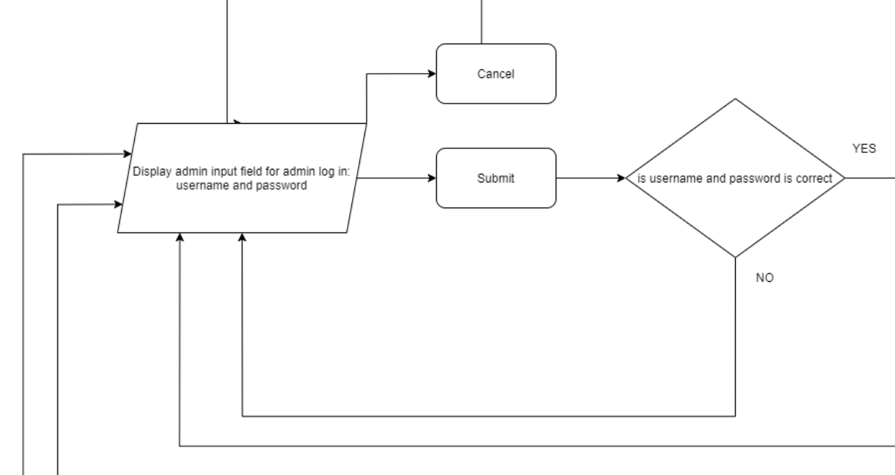
Admin Login Flow Chart
Fig 1: Admin Login Flow Chart
Notes:
Jake

Slide 6
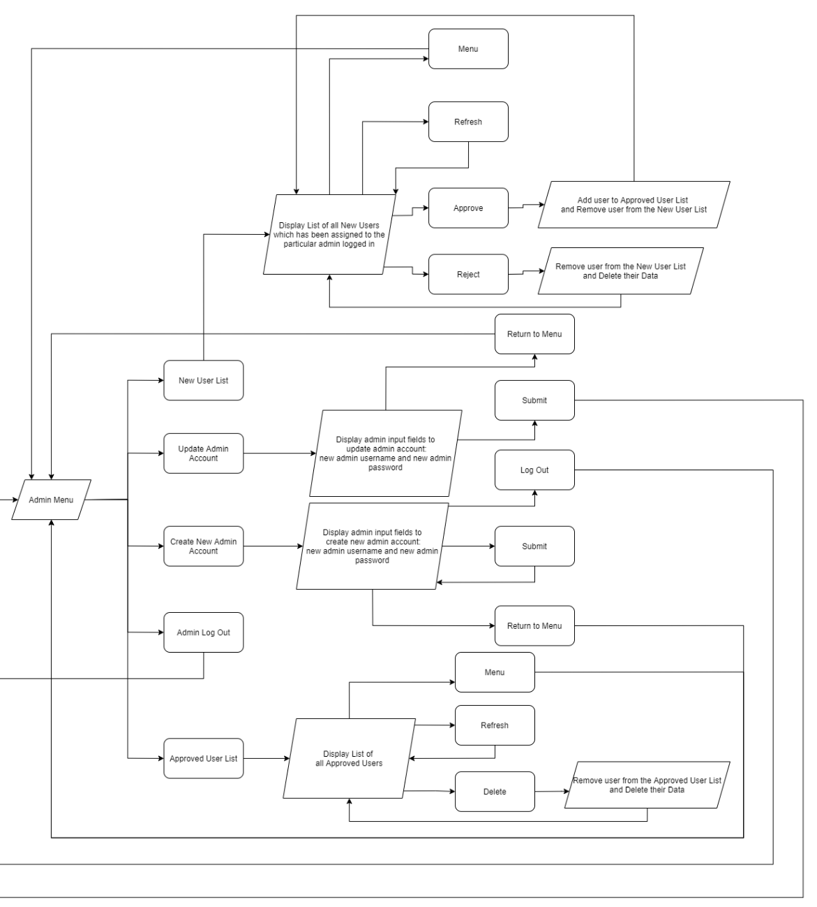
Admin Menu Flow Chart
Fig 2: Admin Menu Flow Chart
Notes:
Emily

Slide 7
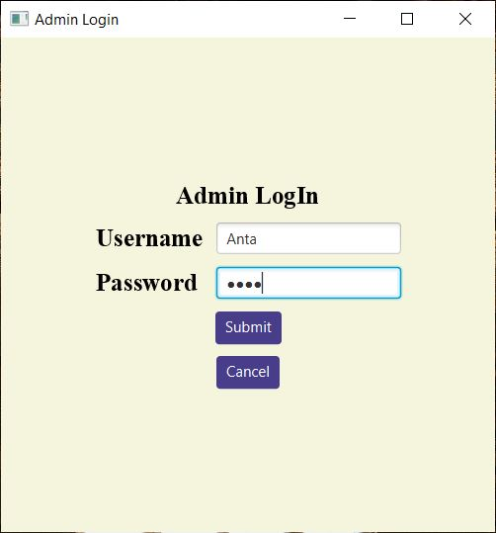
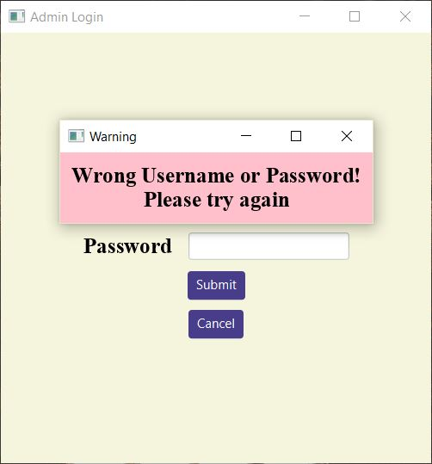
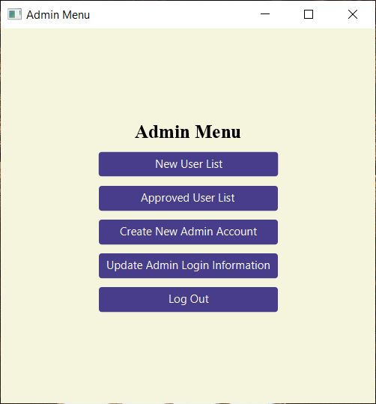
Admin Login, Warning Message, & Admin Menu
Fig 3: Admin Login GUI
Fig 4: Warning Message during Admin Login GUI
Fig 5: Admin Menu GUI
Notes:
Jake

Slide 8
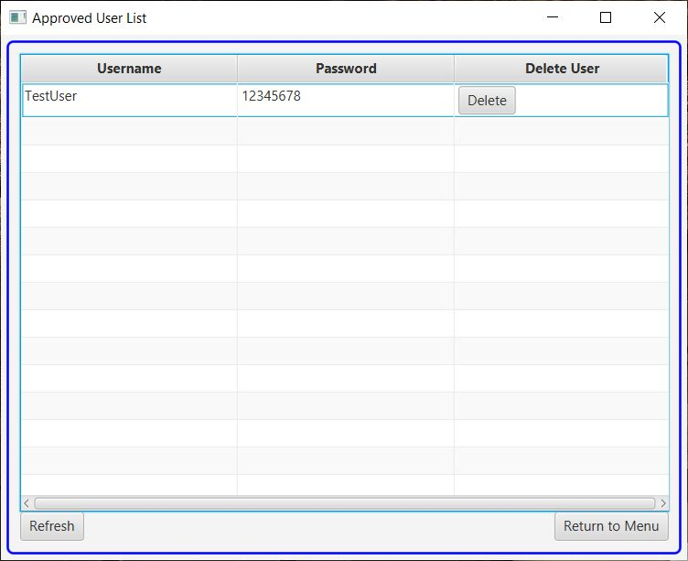
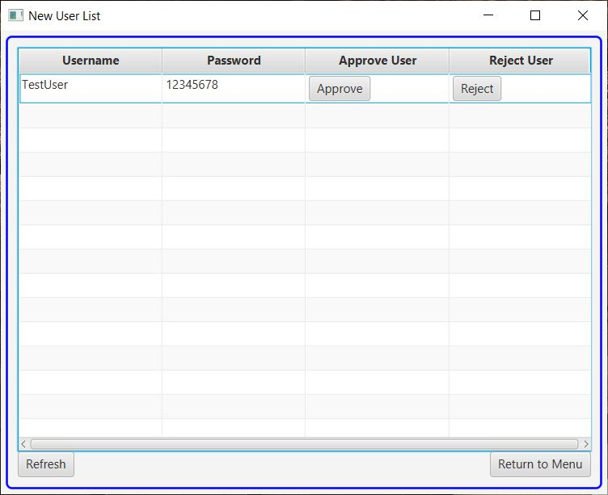
New User List & Approved User List
Fig 6: New User List GUI
Fig 7: Approved User List GUI
Notes:
Emily

Slide 9
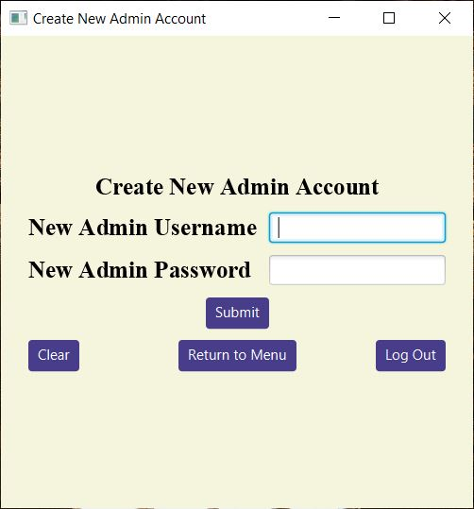
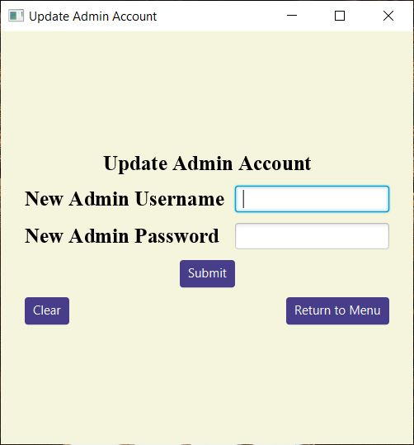
Create New Admin & Update Admin Pages
Fig 8: Create New Admin Account GUI
Fig 9: Update Admin Account GUI
Notes:
Emily

Slide 10
General User
The general user creates a new account
The new user is unable to log into TMS until they are approved by the admin
After an admin approves their account, from the new user list in the Admin Portal, the user logs into TMS.
The user is displayed a menu consisting of the following options:
Calendar:
Displays the current date, month, and year in a calendar format.
The user has the option to search for a particular month and year
The search will output a calendar of the month and year inputted by the user.
Tasks for this Week:
Displays a table listing all the tasks that the user has for this week (7 days) starting from the current local date
Notes:
Nate

Slide 11
General User (cont.)
3. Create New Task:
The user inputs the details for a task and adds the task to TMS
Details include title, start date, start time, end date, end time, and description
4. Search for Task:
Search for a particular task by inputting data in the following fields: title, start date, start time, end date, end time, duration, and description.
Based on the user’s input, TMS outputs all the tasks that match with the user’s request in a tabular form.
5. Delete User:
Removes their username, password, and corresponding recorded data from TMS
6. Log Out:
Logs Out of the portal and returns the user to the user login page.
7. Exit:
Thanks, the user for using TMS and closes the application
Notes:
Nate

Slide 12
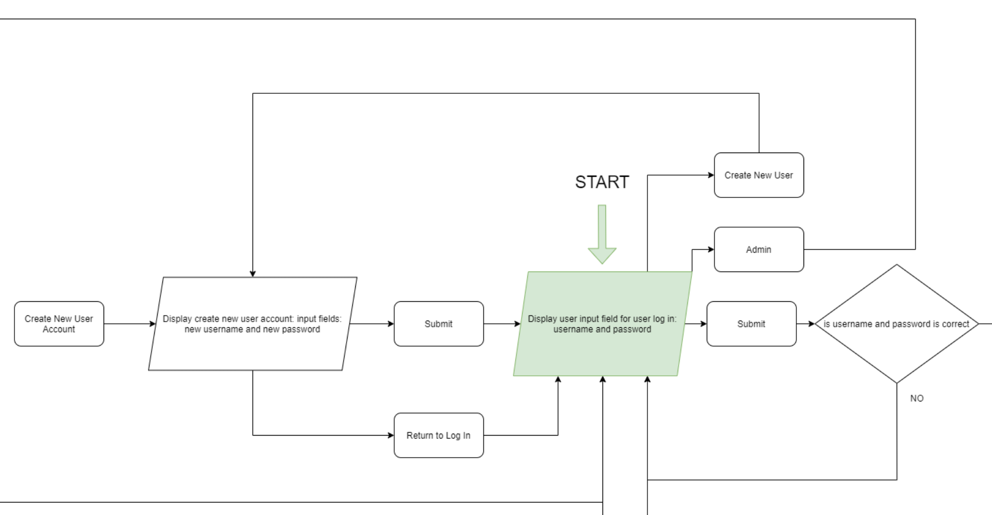
User Login & Create New User Flow Chart
Fig 10: User Login & Create New User Flow Chart
Notes:
Nate

Slide 13
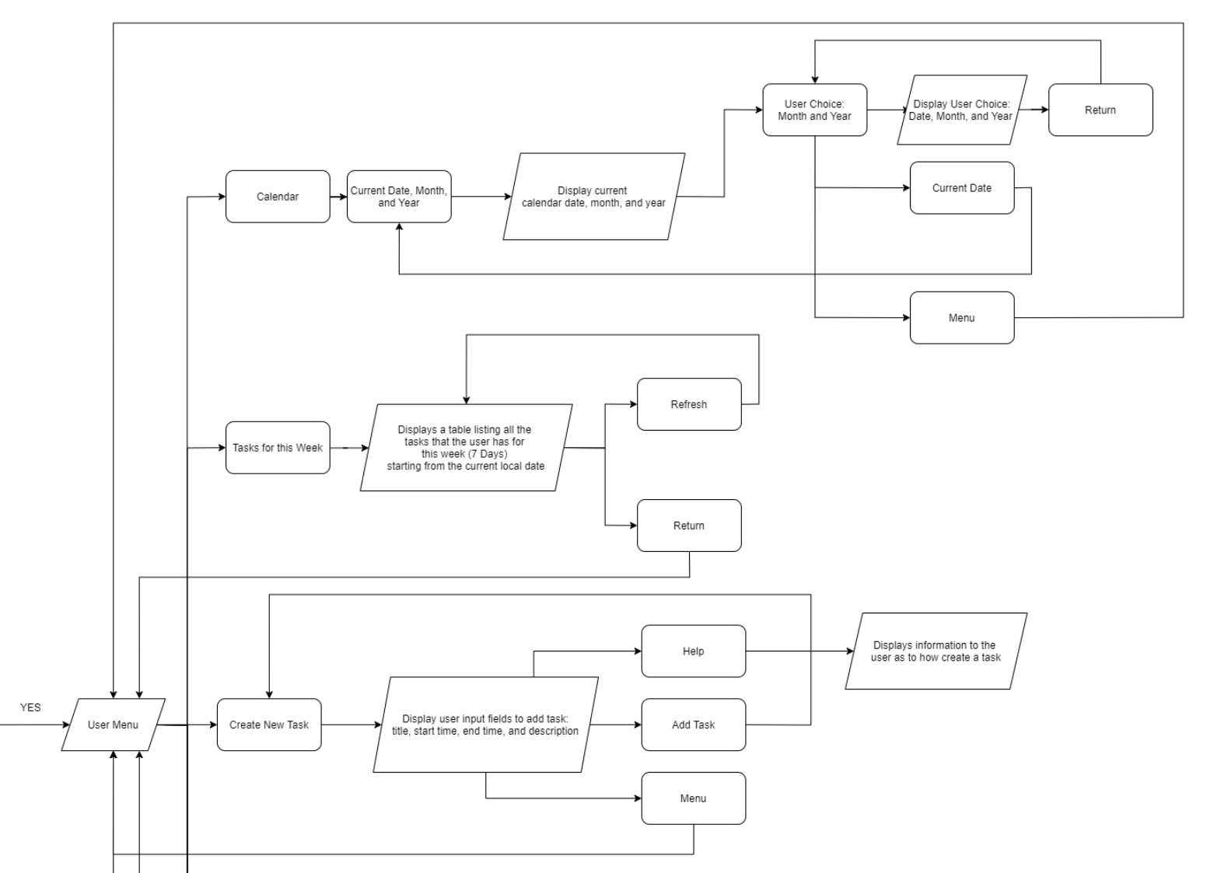
User Menu Flow Chart
Fig 11: User Menu Flow Chart
Notes:
Muntasir

Slide 14
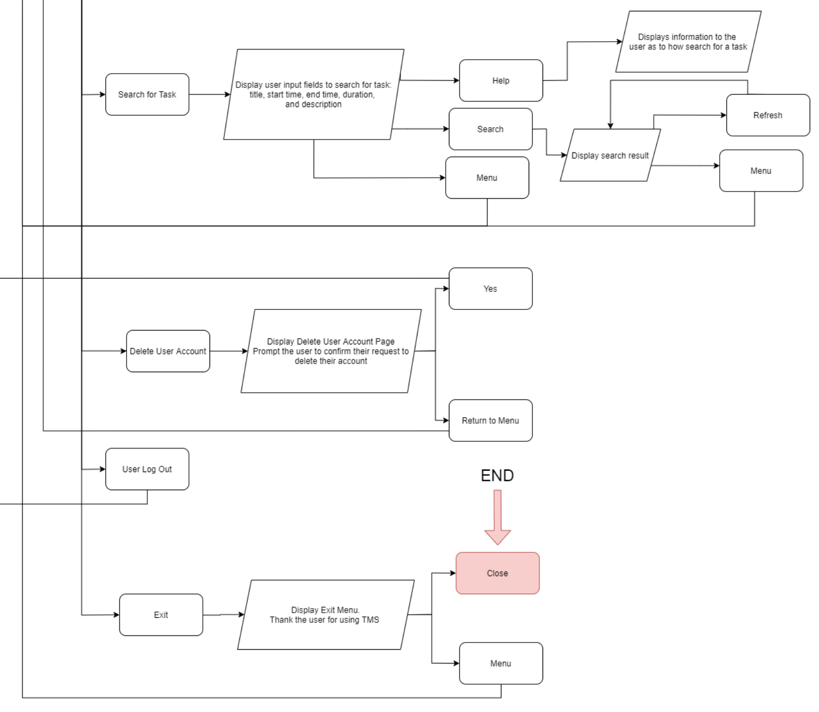
User Menu Flow Chart (cont.)
Fig 12: User Menu Flow Chart
Notes:
Muntasir

Slide 15
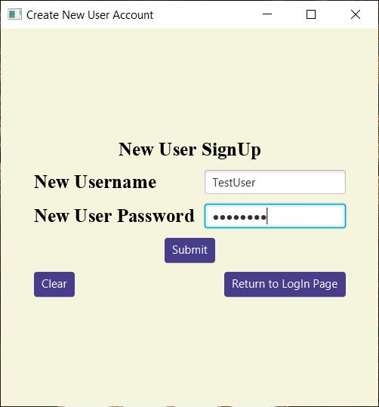
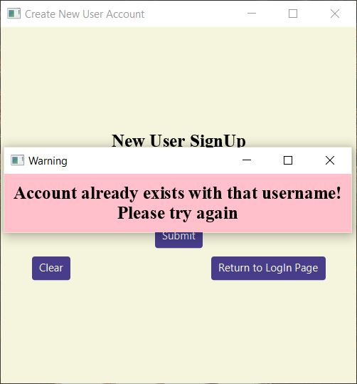
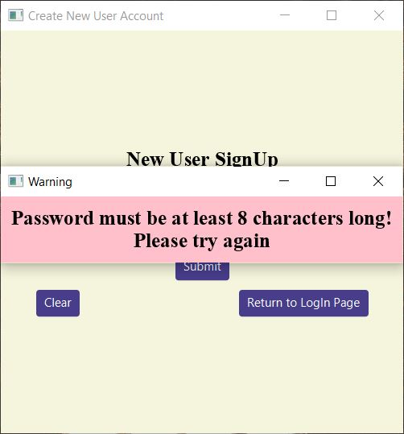
New User Sign Up & Warning Messages
Fig 13: New User Sign Up GUI
Fig 14: Account Exists Warning Message during New User Sign Up GUI
Fig 15: Password Length not met Warning Screen GUI
Notes:
Nate

Slide 16
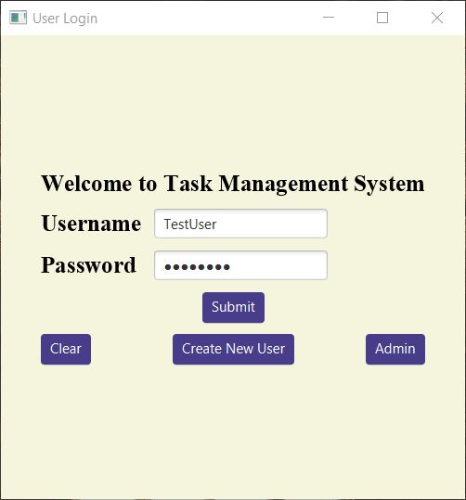
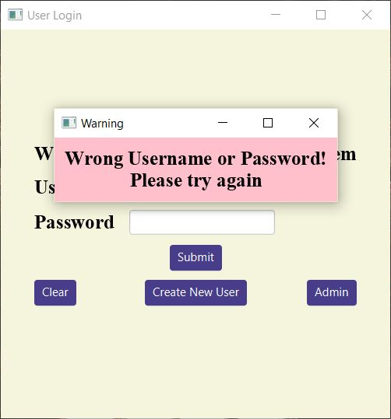
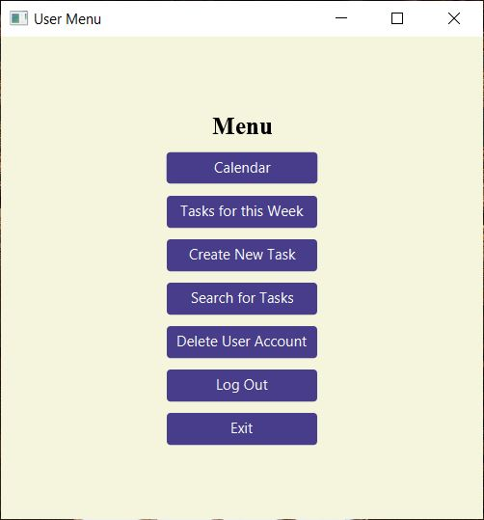
User Login, Warning Message, & User Menu
Fig 16: User Login GUI
Fig 17: Wrong Username or Password Warning Screen GUI
Fig 18: User Menu GUI
Notes:
Nate

Slide 17
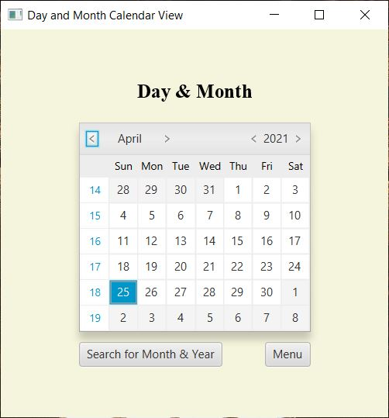
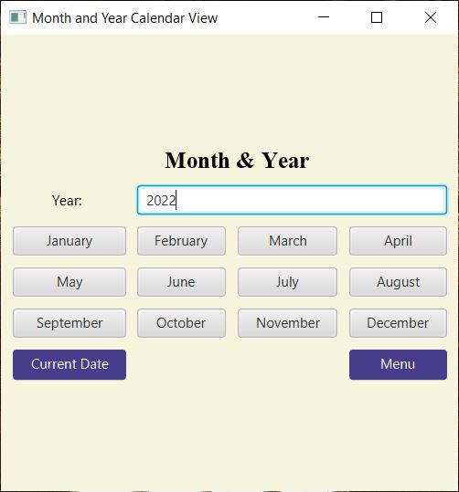
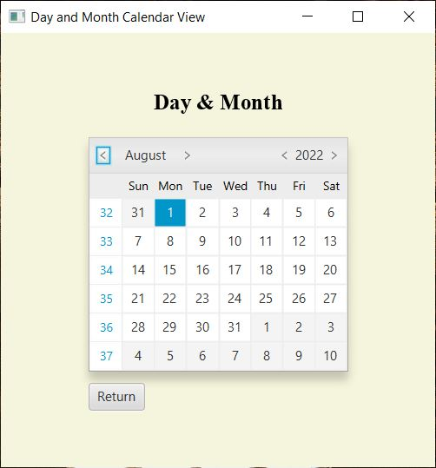
Calendar, Month & Year Search w/ Result
Fig 19: Day and Month Calendar View GUI
Fig 20: Search for Month & Year GUI
Fig 21: Result of the Month & Year Search GUI
Notes:
Anta

Slide 18
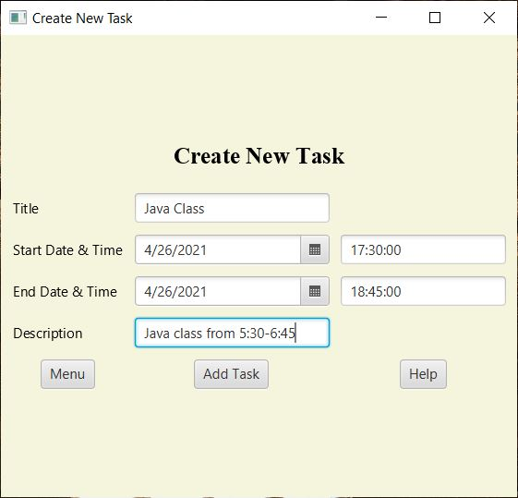
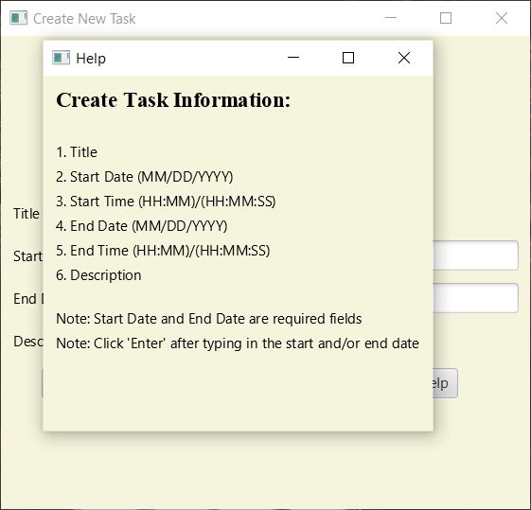
Create New Task Page with Help Menu
Fig 22: Create New Task GUI
Fig 23: Create Task Information GUI
Notes:
Anta

Slide 19
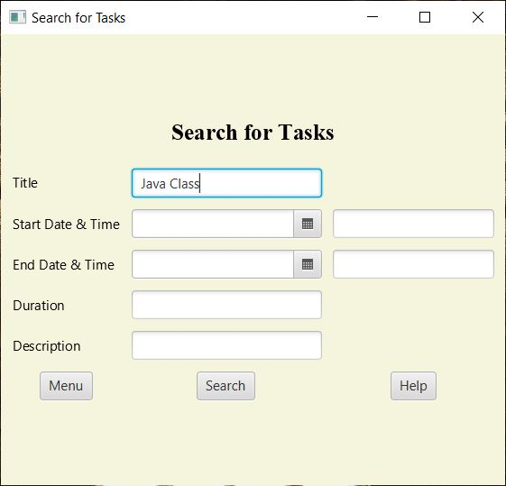
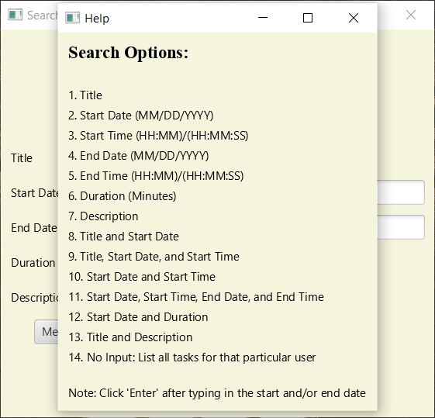
Search for Task Page with Help Menu
Fig 24: Search for Tasks GUI
Fig 25: Search Options GUI
Notes:
Anta

Slide 20
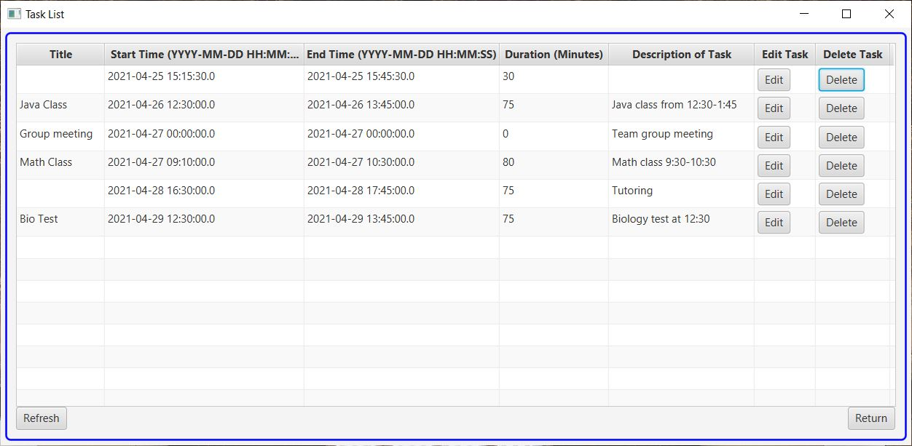
Tasks for this Week Page
Fig 26: Tasks for this Week GUI
Notes:
Emily

Slide 21
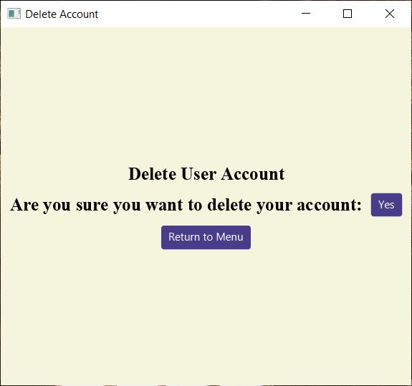
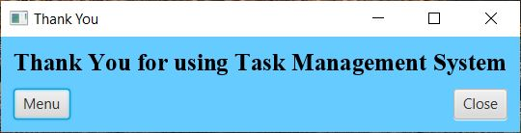
Delete Account Page & Exit Program Page
Fig 28: Exit Message GUI
Fig 27: Delete User Account GUI
Notes:
Emily

Slide 22
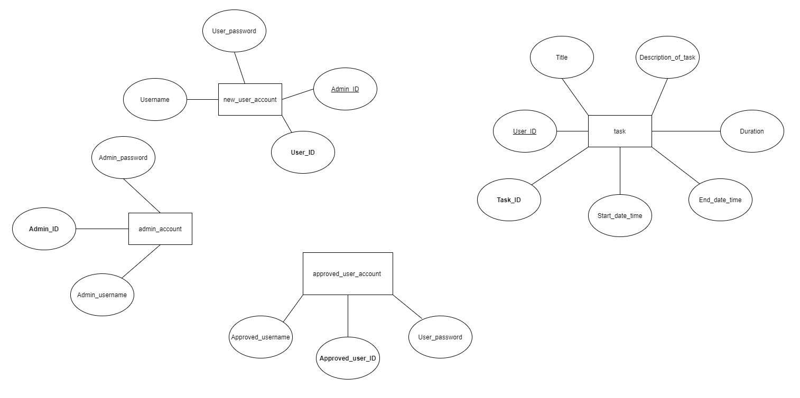
Database
Fig 29: Entity Relationship Diagram
Notes:
Emily

Slide 23
Function Description
Admin & User Log In
Executes a SELECT query with a WHERE condition to determine if the username and password inputted by the user matches exactly (case-sensitive) with one user or admin in their respective table (approved user account or admin account)
Create New Admin & User Account
INSERTs the data collected from user (admin or general) into their appropriate table (admin account or new user account).
Set Database Connection
Connects to a local database by passing in the username, password and JDBC URL to the “DriverManager”
Notes:
Muntasir

Slide 24
Function Description (cont.)
Create New Task
INSERTs into task table, user inputted values for title, start date and start time, end date and end time, description and duration
Search for Task
SELECTs all the tasks from the task table that matches with the user’s input
Displays the tasks in a tabular form using TableView
Converting ResultSet data to Java Object, Observable List & Table View
Executes a SELECT query to retrieve data from a table
ResultSet of the query is passed to a function that converts each row of the set into an object where the fields are initialized with the data from the row
Object is added to an array list to be converted to an ObservableList
List is added to the TableView
Notes:
Muntasir

Slide 25
Function Description (cont.)
Conflict between Tasks on the User’s Calendar
Executes a SELECT query on the task table to determine if there exists a task where the start time or end time of the current task is between the start time and end time of another task
Displays an error
DatePickerSkin
The class is used to display a calendar
Edit Task
UPDATEs task table depending on the specific field (input) being changed by the user
Notes:
Muntasir

Slide 26
Variable Description
Stage
Current stage (parameter) of an Application is passed to another Application when transitioning between stages
ResultSet
Passed to a function that returns an array list of objects containing data from the ResultSet when creating a Table View
Username and Password
User inputted values for username and password are stored in variables and are used to insert into tables when creating new accounts or are used to query tables when trying to verify the credentials of a user
User ID & Admin ID
IDs are passed when transitioning between stages (such as, Log In to Menu) to ensure that the data retrieved is specific to the user of the account
Notes:
Muntasir

Slide 27
Variable Description (cont.)
Title, Start Date Time, End Date Time, Description, Duration
User inputted values for the following fields are stored in variables
Used to insert into the task table when creating a task
Used to query the task table when searching for a task
Boolean “Check”
Passed to the SearchTasksTableViewScreen class
If check is false, then Search for Tasks Page is displayed (Fig. 24)
If check is true, then the Tasks for this Week Page is displayed (Fig. 26)
Notes:
Muntasir

Slide 28
References
[1] GridPane (JavaFX 8), 10-Feb2015. [Online].
Available:https://docs.oracle.com/javase/8/javafx/api/javafx/scene/layout/GridPane.html.
[2] “JavaFX - Layout GridPane,” Tutorialspoint. [Online]. Available: https://www.tutorialspoint.com/javafx/layout_gridpane.htm.
[3]“How to Calculate the Difference Between Two Timestamps in MySQL,” LearnSQL.com. [Online]. Available: https://learnsql.com/cookbook/how-to-calculate-the-difference-between-two-timestamps-in-mysql/.
[4] “MySQL 8.0 Reference Manual :: 11.2.3 The TIME Type,” MySQL. [Online]. Available: https://dev.mysql.com/doc/refman/8.0/en/time.html.
[5] J. Jenkov, “JavaFX HBox,” Tutorials. [Online]. Available: http://tutorials.jenkov.com/javafx/hbox.html.
[6] J. Jenkov, “JavaFX Button,” Tutorials. [Online]. Available: http://tutorials.jenkov.com/javafx/button.html.
[7] “Release: JavaFX 2.2,” Using JavaFX UI Controls: Table View | JavaFX 2 Tutorials and Documentation, 27 Aug-2013. [Online]. Available: https://docs.oracle.com/javafx/2/ui_controls/table-view.htm.
[8] +A. Pomarolli, “JavaFX Table Example: Examples Java Code Geeks - 2021,” Examples Java Code Geeks, 29-Jan-2016. [Online]. Available: https://examples.javacodegeeks.com/desktop-java/javafx-table-example/.
Notes:
Jake

Slide 29
References (cont.)
[9] TableView (JavaFX 8), 10-Feb-2015. [Online]. Available: https://docs.oracle.com/javase/8/javafx/api/javafx/scene/control/TableView.html.
[10] TableColumn (JavaFX 8), 10-Feb-2015. [Online]. Available: https://docs.oracle.com/javase/8/javafx/api/javafx/scene/control/TableColumn.html.
[11] VBox (JavaFX 8), 10-Feb-2015. [Online]. Available: https://docs.oracle.com/javase/8/javafx/api/javafx/scene/layout/VBox.html.
[12] Callback (JavaFX 2.2), 09-Dec-2013. [Online]. Available: https://docs.oracle.com/javafx/2/api/javafx/util/Callback.html.
[13]“26 Date Picker,” 26 Date Picker (Release 8). [Online]. Available: https://docs.oracle.com/javase/8/javafx/user-interface-tutorial/date-picker.htm.
[14] DatePicker (JavaFX 8), 10-Feb-2015. [Online]. Available: https://docs.oracle.com/javase/8/javafx/api/javafx/scene/control/DatePicker.html#:~:text=The%20DatePicker%20control%20allows%20the,time.
[15]“How to Get the Date from a Datetime Column in MySQL,” LearnSQL.com. [Online]. Available: https://learnsql.com/cookbook/how-to-get-the-date-from-a-datetime-column-in-mysql/#:~:text=In%20MySQL%2C%20use%20the%20DATE,of%20the%20timestamp%20data%20type.
Notes:
Jake

Slide 30
Thank You
Notes:
Jake

